Slide 1
Microsoft Visio
Dr. Sonal Dekhane
ITEC 3200

Slide 2
Introduction
Diagramming program
Creates vector graphics
Visual tool to create data models and database design
Three versions: Standard, Professional and Premium
We will use Professional

Slide 3
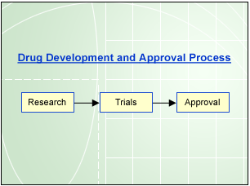
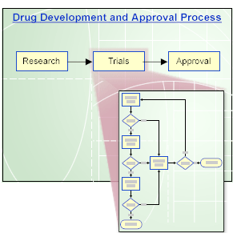
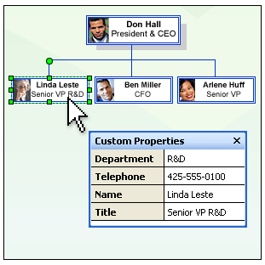
What can Visio be Used for?
F
Business Process Diagram
Flowchart with hyperlink to more details
Organizational chart

Slide 4
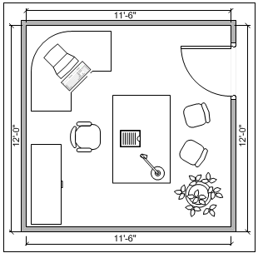
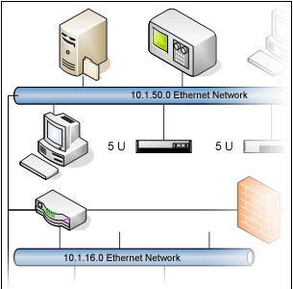
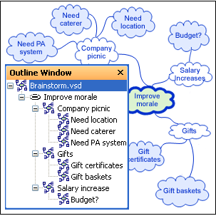
Building Plans
Network Diagrams
Brainstorming Diagrams

Slide 5
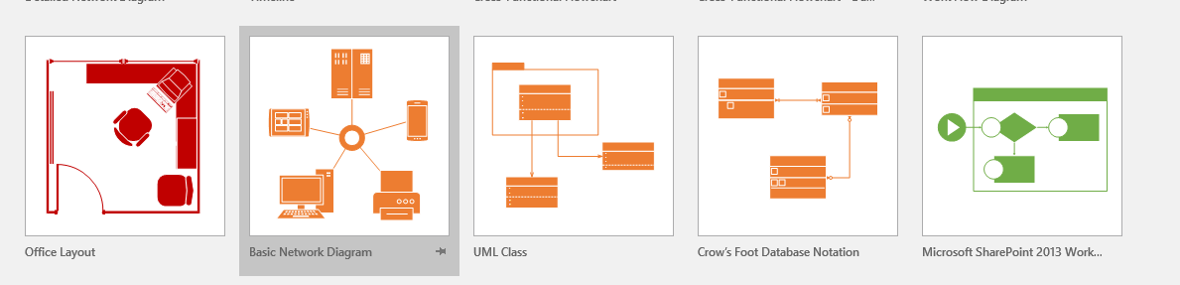
Launch Visio

Slide 6
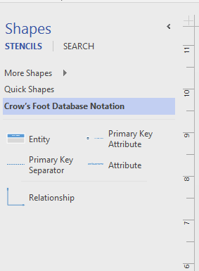
Create Entity
Drag Entity and drop on the drawing window
Start typing Attribute names in the entity
Identifiers go in the “PK” row

Slide 7
Create Relationships
Drag Relationship object and drop between two entities
Drop each end to an entity, ensuring that the “whole” entity highlights to assure connection
Right click on the connector and as necessary
Change “set begin symbol”
Change “set end symbol”
Change “Set Identifying”

Slide 8
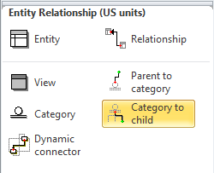
Modeling IS-A relationships Visio 2010
Use the Category shape to create a
supertype-subtype relationship.
Parent to category and category to child
shapes can be used to establish the
correct relationships.

Slide 9
Tasks
Open MS Visio
Create a new Database Model Diagram Document
Save it as employee-department-model
Create Employee entity
Drag and drop the “Entity” shape from the Shapes window to the Drawing area
A table object is added to the Drawing, not just a shape
Name the entity “Employee”

Slide 10
Tasks
Add other attributes to the entity
EmployeeID(Required)
FirstName (Required)
LastName (Required)
Phone (Required)

Slide 11
Tasks
In the same way create a Department entity that has following attributes:
DepartmentID is Primary Key
DeptName (Required)
DeptOffice (Required)
DeptPhone (Required)
Next, create a Project table that has the following attributes:
ProjectID is Identifier
ProjectName (Required)

Slide 12
Tasks
Finally, create a Team table that has the following attributes:
TeamNum Not Null and Identifier
ProjectID Not Null and Identifier
TeamLead Not Null

Slide 13
tasks
Create the following relationship between Employee and Department entities
Each employee has to work in a department and can work in only one department
Each department can have many employees, and has to have at least one
Project and Team:
A team cannot exist and cannot be identified without project entity
Each project can have many teams and has to have at least one
Each team belongs to one project and has to belong to a project

Slide 14
Tasks
Employee and Team:
Each employee can be assigned to many teams, but does not have to be on any
Each team can have many employees and has to have at least one

Slide 15
TASKS
Save the data model as Employee-Department-Model.vsd (Visio Drawing)
For further editing, if necessary
Also save it as a .pdf
For sharing with others

Slide 16
TASKS
Update the data model to represent the fact that Employees can be either full-time or part-time employees
They can only be either full or part-time, no both
A discriminator should be used to represent this fact
All employees will have an employee id, first name, also name and phone
Full-time employees in addition will have a monthly salary
Part-time employees in addition will have an hourly wage rate and maximum hours allowed
Save updated drawing as Version2 of the previous one in both formats (.vsd and .pdf)

Slide 17
Class Activity
Draw a data model for parts A and B of Highline University case and submit the pdf files for each part in the “Visio In-class” Assignment folder on D2L.

